Slide 1
Credit One Report Course 2-Task 2
Alex Guevara

Slide 2
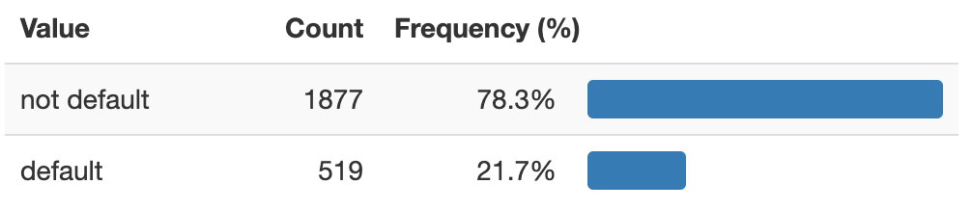
Default Status Frequencies
The percent of Defaulted Clients is nearly 22%, impacting loss of revenue and Credit One Clients
How can we decrease default rates and increase business opportunities for Credit One?

Slide 3
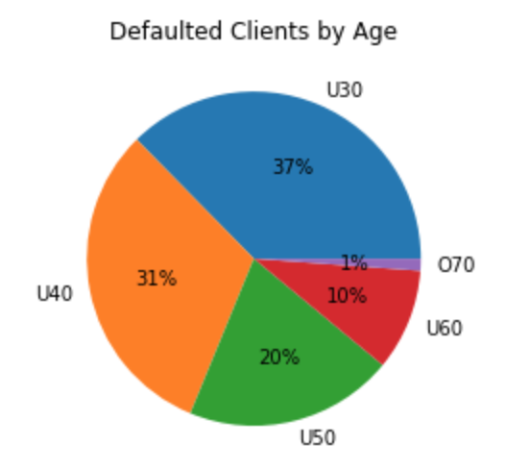
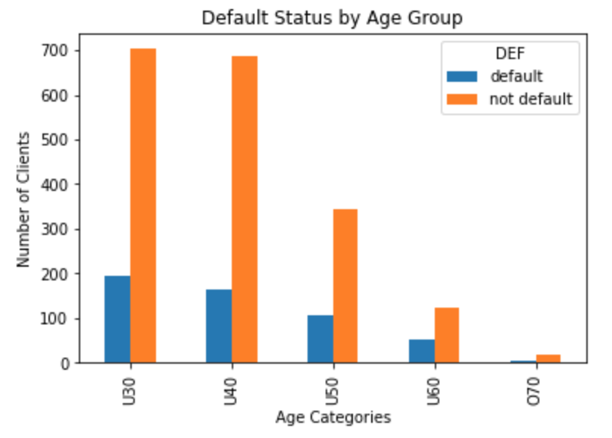
Default Status by Age
By Age Category, the Under 40 and Under 30 age groups encompass 68% of defaulted clients
The Under 30 and Under 40 age groups yield similar number of defaulted clients

Slide 4
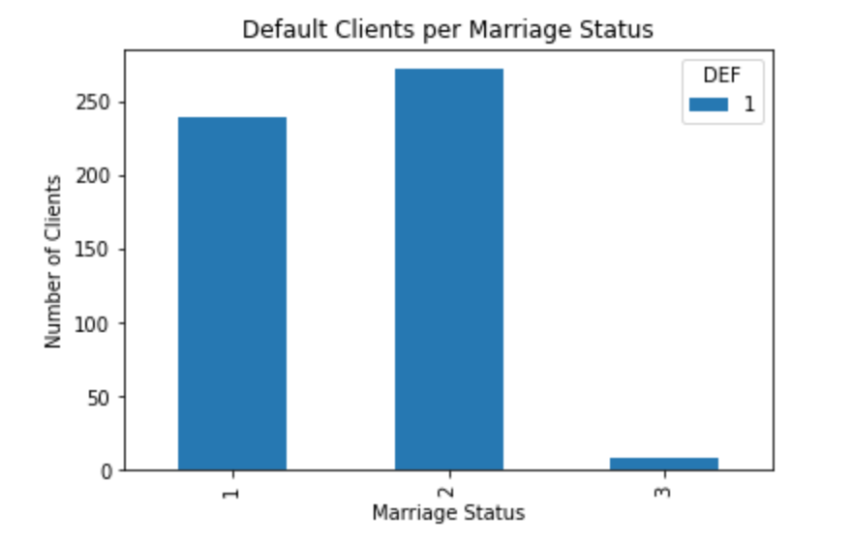
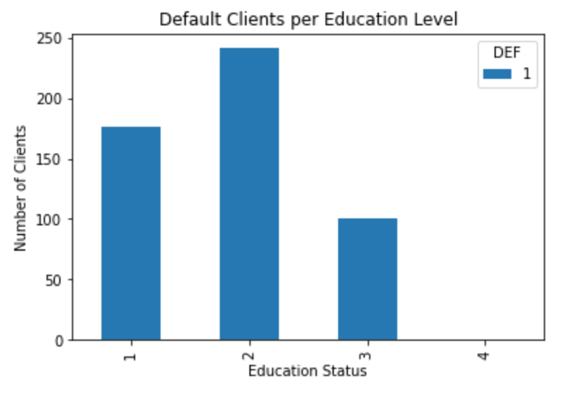
Default Client Trends
There are more defaulted Graduate School (1) and University (2) Clients than High School (3) Clients
There are more defaulted Married (1) and Single (2) Clients than Divorced (3) Clients

Slide 5
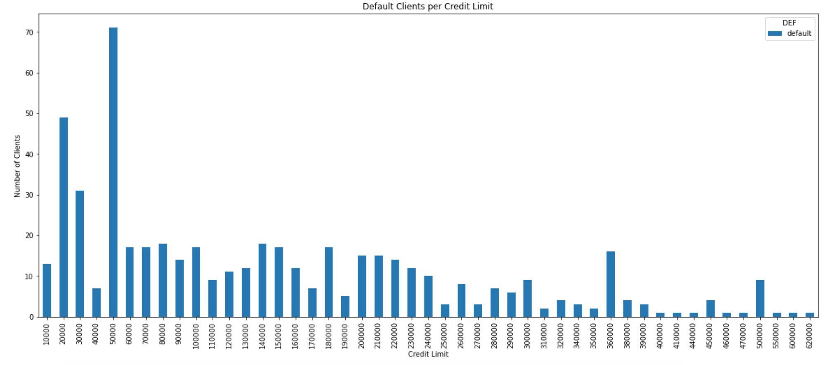
Defaulted Credit Limits
Mean | St Dev | Min | 25% | 50% | 75% | Max
$145K | $121K | $10K | $50K | $110K | $210K | $620K

Slide 6
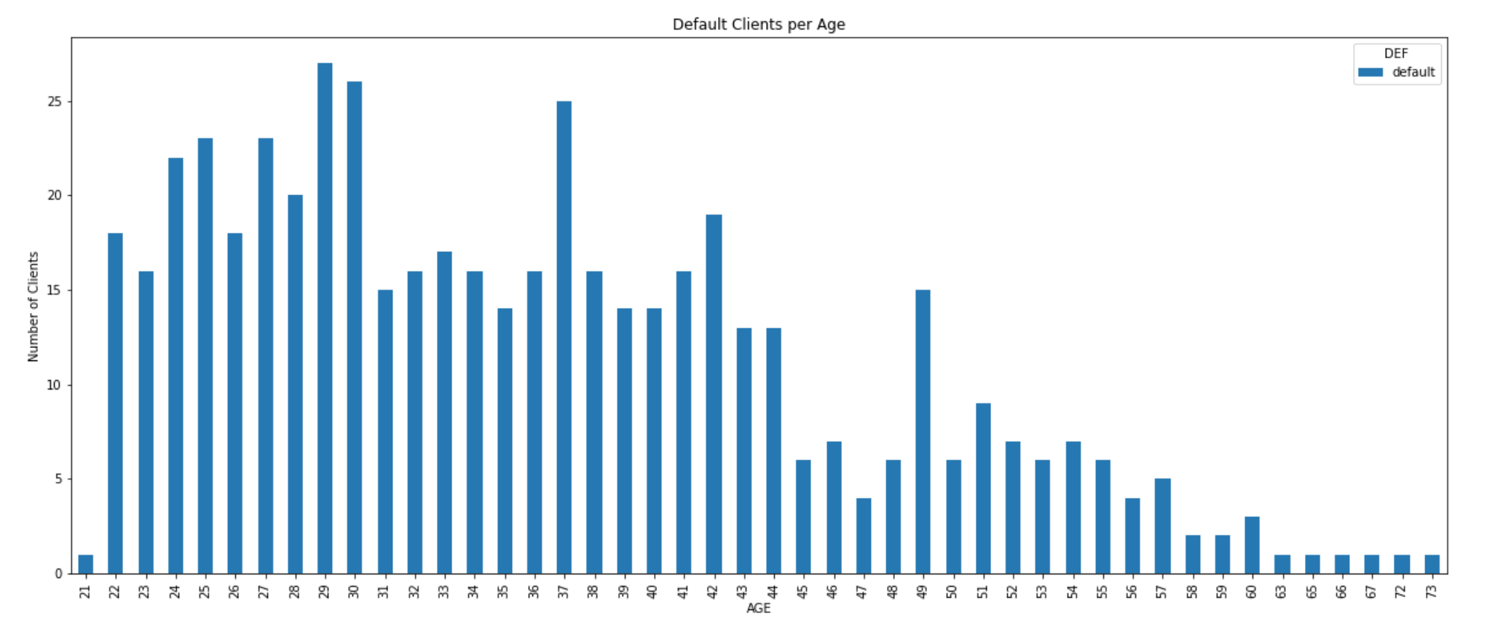
Default Clients by Age
Mean | St Dev | Min | 25% | 50% | 75% | Max
36 | 10 | 21 | 28 | 35 | 42 | 73

Slide 7
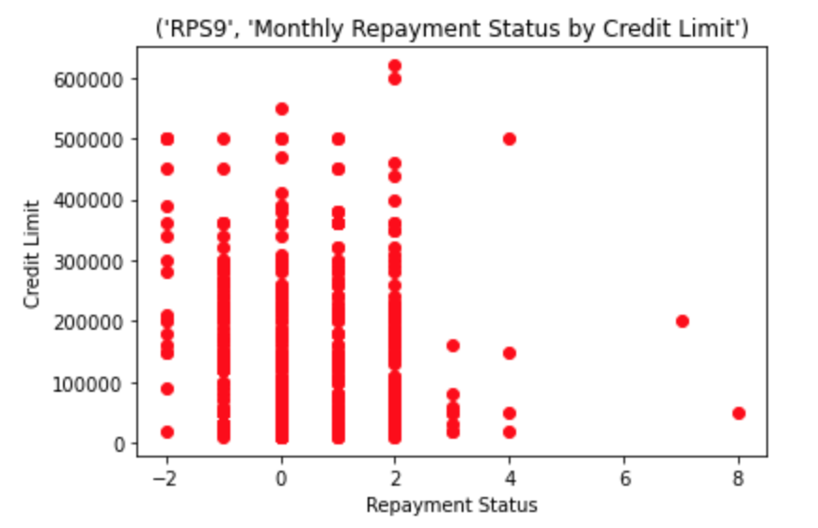
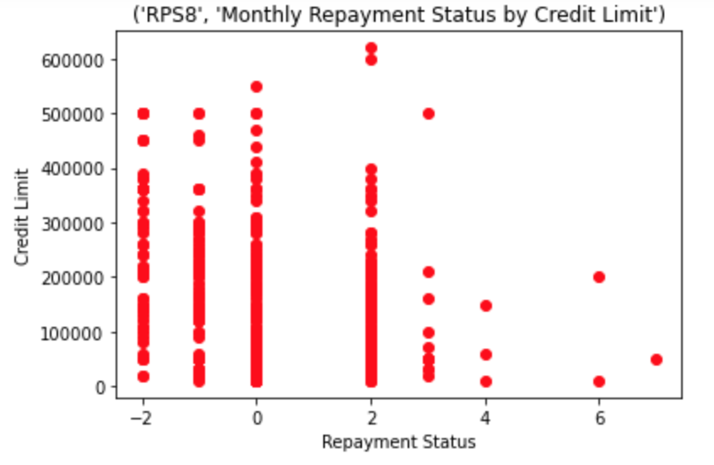
Default Client Repayment Status
Based on September and August Months
Lower credit limit default clients are taking longer to repay
Future Considerations
Re-analyze delayed payments in the 3rd and 4th quartile
RPS | Min | 25% | 50% | 75% | Max
September | -2 | 0 | 1 | 2 | 8
August | -2 | -1 | 0 | 2 | 7
July | -2 | -1 | 0 | 2 | 7
June | -2 | -1 | 0 | 0 | 7
May | -2 | -1 | 0 | 0 | 7
April | -2 | -1 | 0 | 0 | 8

Slide 8
Credit One Conclusions
Credit One potential business value from this analysis
Combined, 68% of defaulted clients are comprised of Under 40 and Under 30 age groups
It is difficult to discern default trends by Marriage or Education Status
Per Credit Limit, the average default credit limit was $145,000
The average age for defaulted clients is 36
There may be a trend of lower credit limit clients who take longer for repayment
Future Recommendations
Re-analyze delayed payments in the 3rd and 4th quartile
Determine any additional trends based on Age, Credit Limit, Repayment status,

